Slide 1
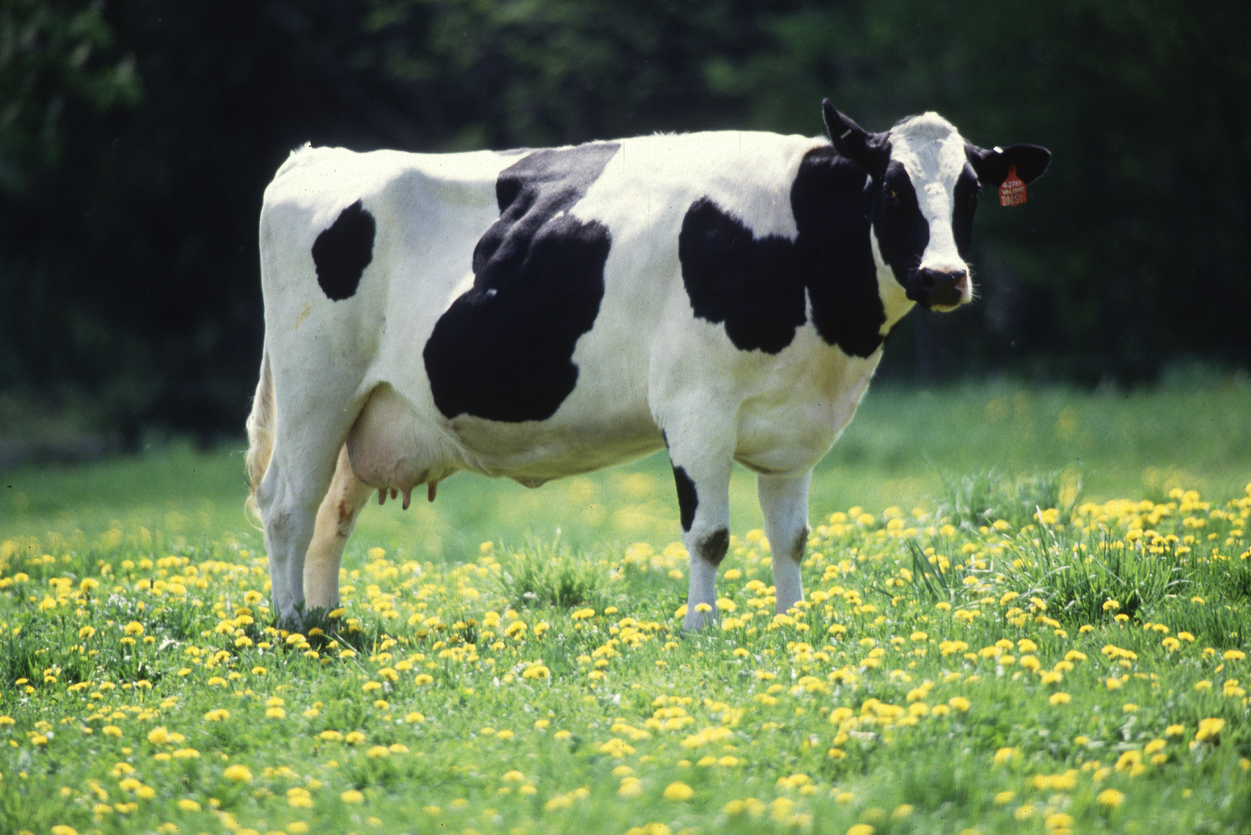
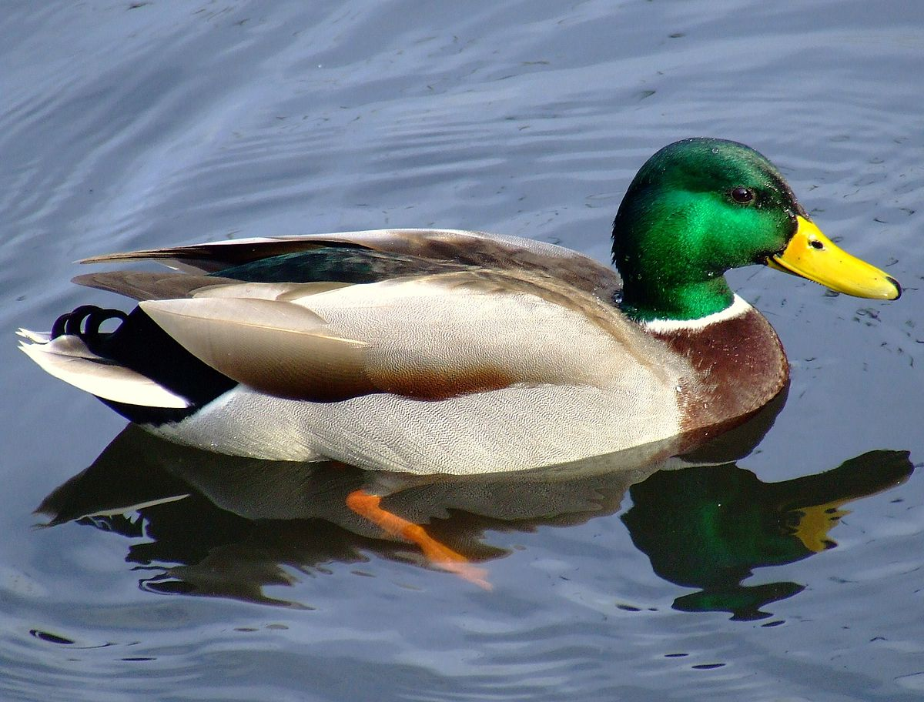
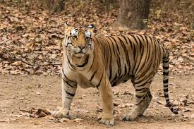
Daily Review
A characteristic is a feature of an object.
On your whiteboard, list 3 characteristics these animals have in common.
On your whiteboard, list 2 characteristics that are different between the animals.

Slide 2
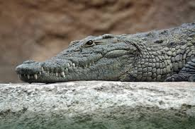
Daily Review
All living things have 7 characteristics in common.
They can be remembered by using the acronym MR GREEN
Move to find the resources they need
Respond to changes in their environment
Grow as they get older
Reproduce to make new individuals
Excrete waste products from their bodies
Exchange gases with their environment
Nutrition from food and water
On your whiteboards, write down which characteristics the crocodile shows. Is it a living thing?

Slide 3
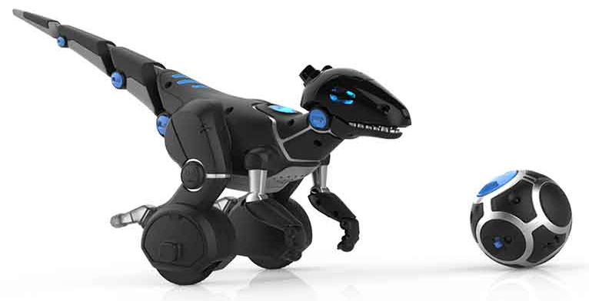
Daily Review
All living things have 7 characteristics in common.
They can be remembered by using the acronym MR GREEN
Move to find the resources they need
Respond to changes in their environment
Grow as they get older
Reproduce to make new individuals
Excrete waste products from their bodies
Exchange gases with their environment
Nutrition from food and water
On your whiteboards, write down which characteristics the robotic dinosaur shows. Is it a living thing?

Slide 4
Responding to Change

Slide 5
Learning Objectives
CFU
What are we going to learn?
Define the terms stimulus and receptor within the context of the body.
Describe examples of stimulus-response for each sense organ.
Activate Prior Knowledge
Our bodies regularly respond to changes without consciously acknowledging it.
Think, Pair, Share:
How do you know when you’re hungry or thirsty?

Slide 6
Concept Development
CFU 1
What is a stimulus?
Stimuli and Receptors
A stimulus is any information that the body receives, causing a response.
They can be changes in our environment or changes within the body, e.g. a hot day or low blood sugar.
A receptor is a structure that detects a stimulus or change in the normal functioning of the body, and sends information to the brain.
CFU 2
Think, Pair, Share: List two examples of a change in the environment to which our bodies would respond.
CFU 3
Think, Pair, Share: List two examples of a change within our bodies which would cause a response.
CFU 4
How are stimuli and receptors related to one another?

Slide 7
Concept Development
CFU 1
What are the five sense organs?
Sense Organs
Humans have five main senses: sight, hearing, taste, smell, and touch.
The sense organs (eyes, ears, tongue, nose, and skin) are highly specialised to receive stimuli from the environment.
CFU 2
Think, pair, share: Describe a stimulus from the environment that the nose would respond to.
CFU 3
Think, pair, share: Do sense organs detect internal or external stimuli? Explain your choice.

Slide 8
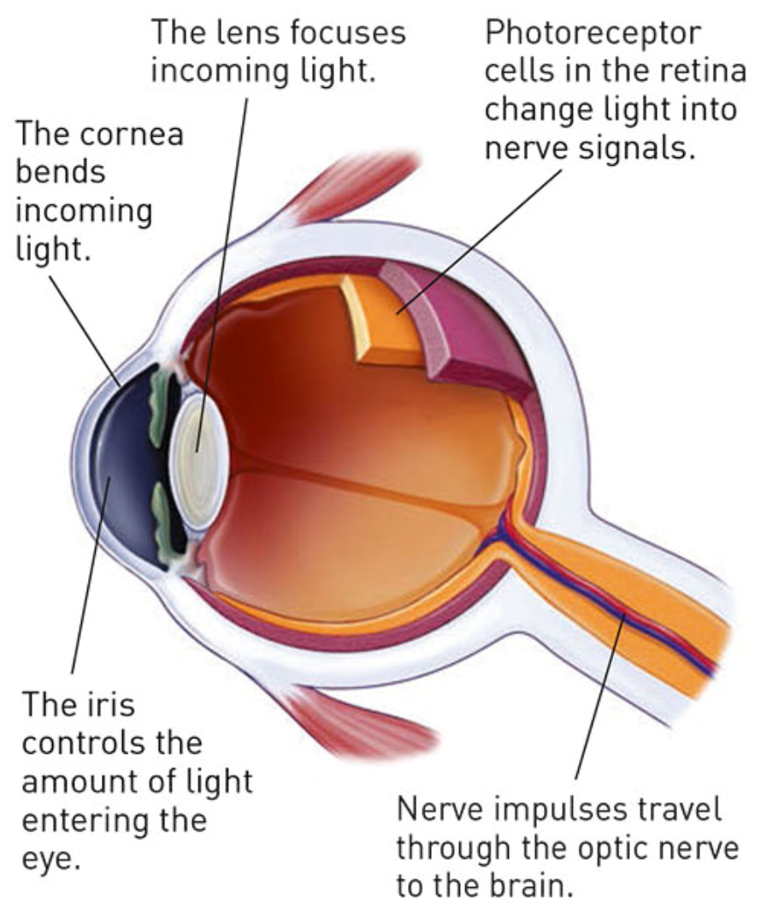
Concept Development
CFU 1
How does sight occur?
Sight
Sight occurs when photoreceptor cells at the back of the eye transform light into nerve signals for the brain.
The brain interprets this information, telling us what we are seeing.
CFU 2
Think, pair, share: Name a situation to which our eyes would respond.

Slide 9
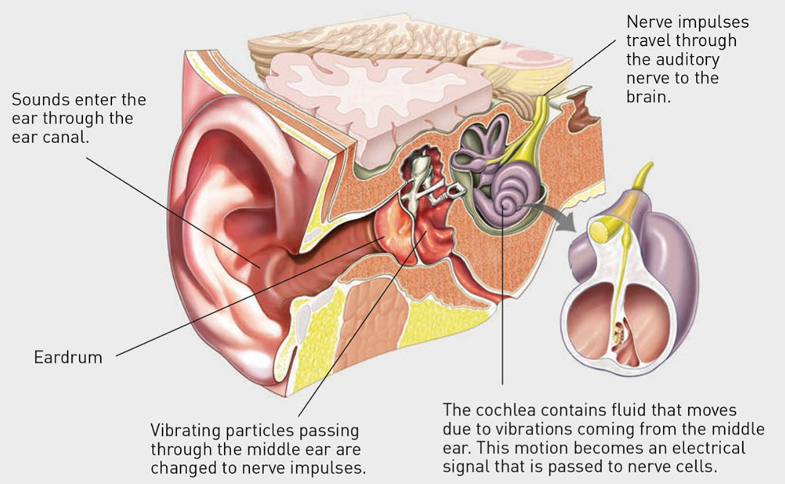
Concept Development
CFU 1
What causes the eardrum to vibrate?
Hearing
Sounds cause the particles in the air to vibrate.
The movement of air particles causes the eardrum to vibrate, sending information through mechanoreceptors in the ear and into the brain.
CFU 2
Think, pair, share: Name a situation to which our ears would respond.

Slide 10
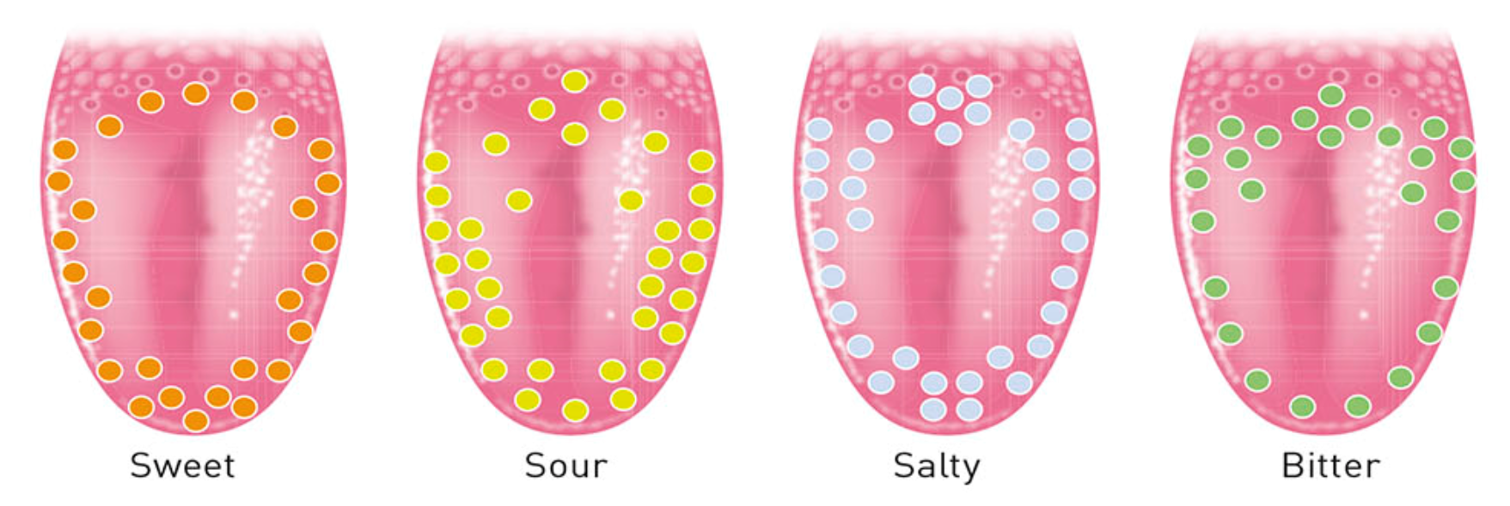
Concept Development
CFU 1
How does our brain recognise what is being eaten?
Taste
The tongue is covered in thousands of taste buds.
Each taste bud contains receptor cells that react to chemicals in food.
Taste buds recognise sweet, salty, sour, and bitter tastes.
Information from the taste buds is transferred to the brain to recognise what is being eaten.
CFU 2
Think, pair, share: Name a situation to which our taste buds would respond.

Slide 11
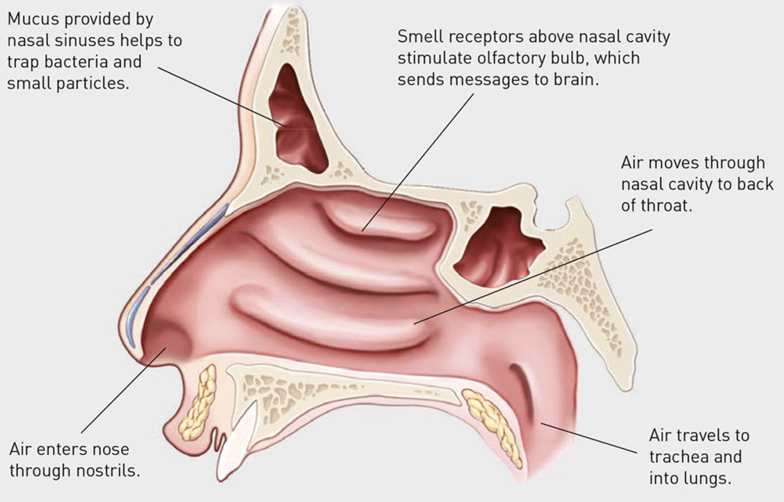
Concept Development
CFU 1
What do chemical receptors in the nose do?
Smell
Nostrils contain chemical receptors that detect chemicals in the air.
These receptors then send signals to the brain to interpret what we are smelling.
Smell is closely linked to taste.
CFU 2
Think, pair, share: Why are the senses of smell and taste closely linked?

Slide 12
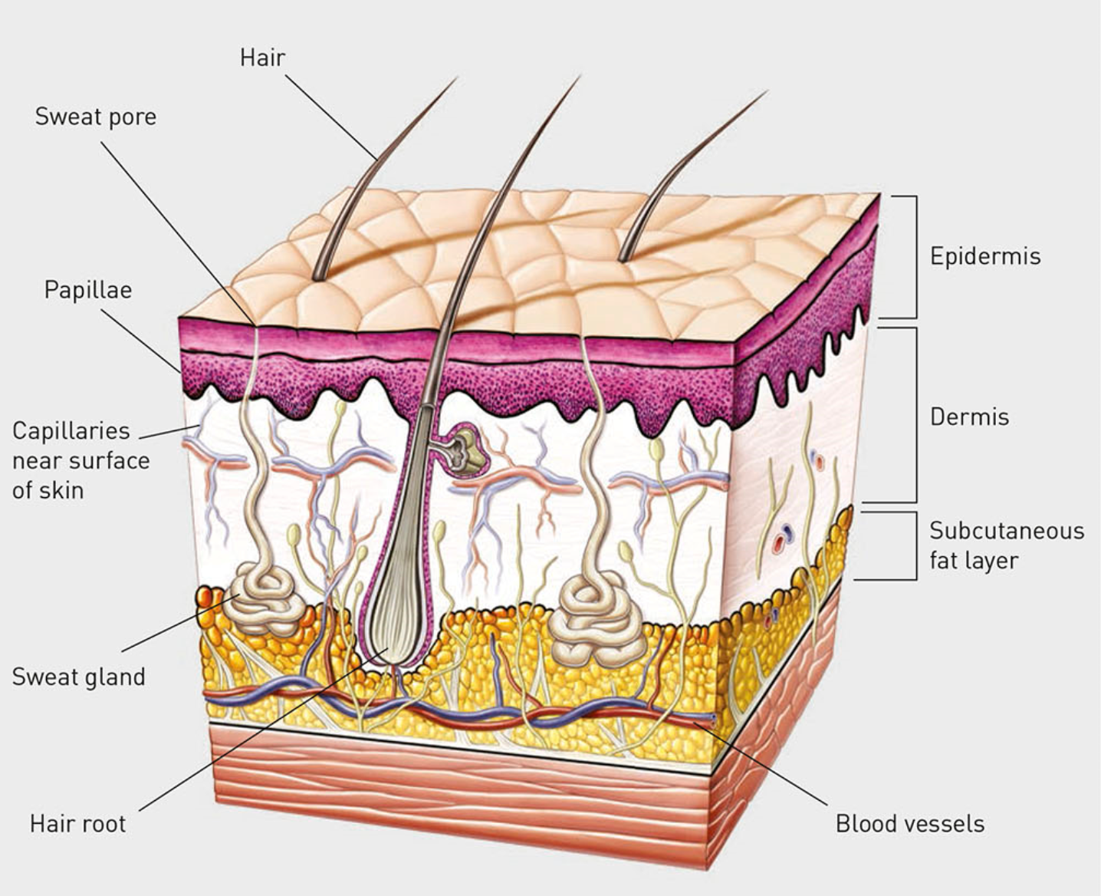
Concept Development
CFU 1
What do touch receptors detect?
Touch
Touch is felt all over the body through the skin.
The bottom layer of skin (dermis) contain receptors that detect heat, cold, pressure, and pain.
Information is sent from these receptors to the brain for interpretation and processing.
CFU 2
Think, pair, share: what are two situations in which our bodies would respond to pressure?

Slide 13

Skill Development/Guided Practice
Describing Stimulus-Response
State the stimulus. State the stimulus organ/receptor. Describe the response.
Heather takes off her jumper on a hot day.
The stimulus in this situation is heat. The stimulus organ is the skin, and the response is removing her jumper.

Slide 14

Skill Development/Guided Practice
Describing Stimulus-Response
State the stimulus. State the stimulus organ/receptor. Describe the response.
Rachel’s mum turns on her bedroom lights to wake her up.
The stimulus in this situation is light. The stimulus organ is the eye, and the response is shutting her eyes to block the light.

Slide 15
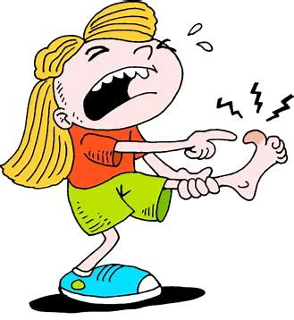
Skill Development/Guided Practice
Describing Stimulus-Response
State the stimulus. State the stimulus organ/receptor. Describe the response.
Annie steps on a pin.
The stimulus in this situation is pain. The stimulus organ is the skin, and the response is stepping off of the pin.

Slide 16
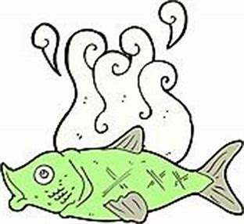
Skill Development/Guided Practice
Describing Stimulus-Response
State the stimulus. State the stimulus organ/receptor. Describe the response.
Robbie walks by some old and rotting fish.
The stimulus in this situation is smell. The stimulus organ is the nose, and the response is blocking the passage of air to the nose.

Slide 17
Relevance
Our bodies are complex organisms that are constantly interpreting external and internal information.
Knowing about the senses and sense organs will help you understand how we respond to changes in the world around us.

Slide 18
Skill Closure
Explain the difference between a stimulus and a receptor.
Skill Closure
Match the following sense organs with the stimulus that the receptors detect.
1. Eye A Pain, pressure, heat, cold
2. Ear B Light and movement
3. Nose C Chemicals in food
4. Tongue D Chemicals in the air
5. Skin E Vibrations in air particles
Describing Stimulus-Response
State the stimulus. State the stimulus organ/receptor. Describe the response.
Skill Closure
Tiana eats a sour lolly. Describe the stimulus-response in this situation.

Slide 19
Independent Practice
Answer the following questions in your book or on your device.
Describe the difference between a stimulus and a response.
Give two examples of stimuli outside the body and two within the body.
Complete the table below to summarise the sensory organs and their stimuli.
Sensory Organ | Stimulus | Receptor Type | Example of Stimulus - Response
Marigold
Rafflesia
Trumpet Vine
Cactus
Jasmine
Bottlebrush

Slide 20
Independent Practice
Complete the Testing Your Senses worksheet on your device or a paper copy.
Marigold
Rafflesia
Trumpet Vine
Cactus
Jasmine
Bottlebrush

